Slide 1
Chapter Eight*
More About Strings
*Based on Starting Out with Python by Tony Gaddis

Slide 2
Chapter Eight– More About Strings
8.1 Basic String Operations
8.2 String Slicing
8.3 Testing, Searching, and Manipulating Strings

Slide 3
8.1 Basic String Operations
So far we have looked at strings as data types and string conversions from files and the keyboard
Python provides several ways to access individual characters in strings
There are many uses for manipulating strings:
Word Processing
Email Programs
Search Engines
All of the above require use of extensive string operations

Slide 4
Accessing Individual Characters in a String - Iterating Over a String
Sometimes it is required to access individual characters in a string
Example – password processing – checking for Uppercase letters, special characters, digits, etc.
Processing a string character by character can be done with a loop
The easiest way to process a string is to iterate over it with a for loop:
for variable in string:
statement
statement

Slide 5
Iterating over a string with the for loop
name = ‘Juliet’
for ch in name:
print (ch)
>J
>u
>l
>i
>e
>t

Slide 6
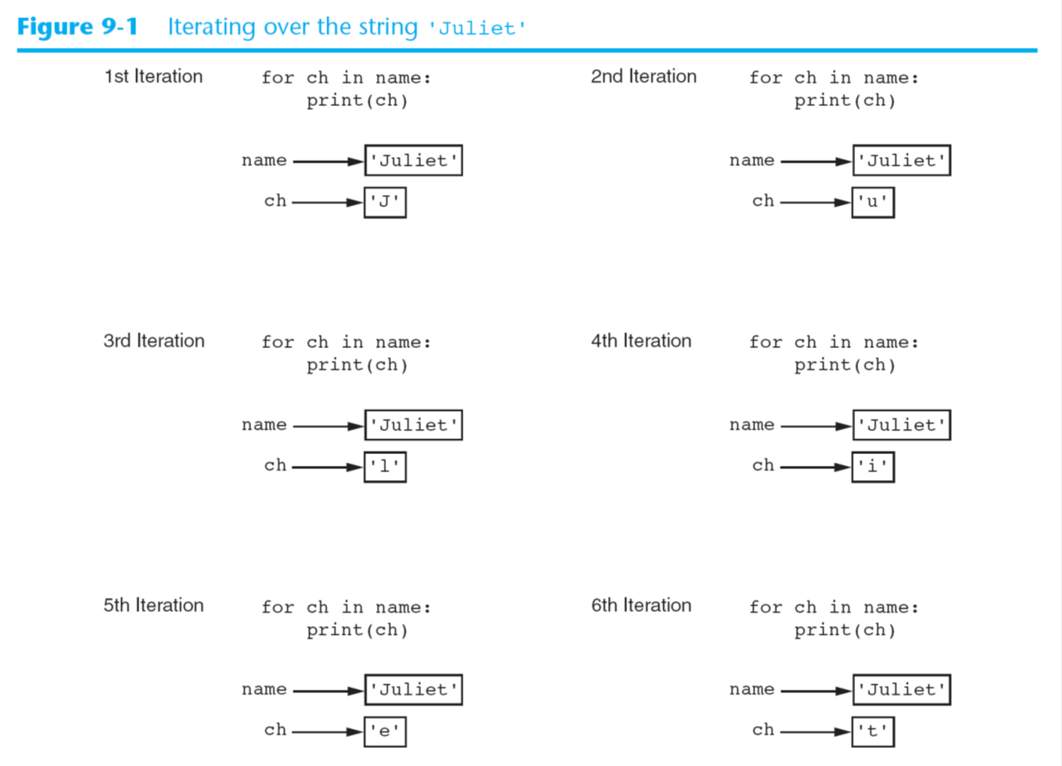
Iterating over a string with the for loop
Note that the value of ch in the loop cannot be changed

Slide 7
Iterating over a string with the for loop

Slide 8
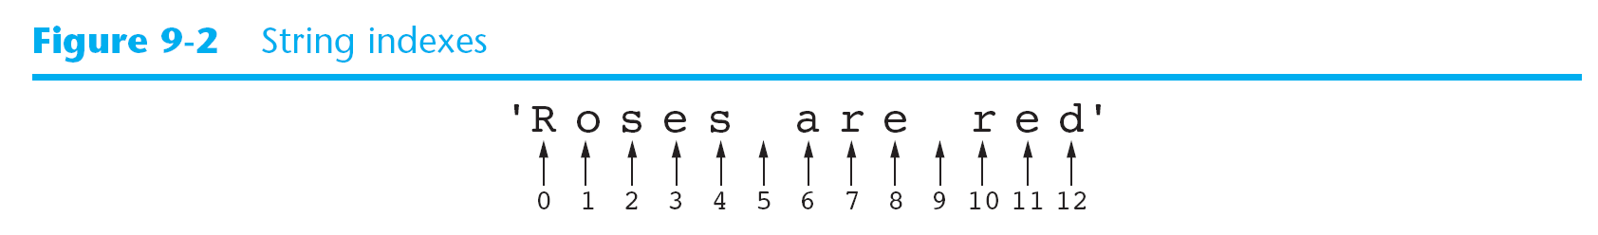
Indexing
Individual characters in a string can be indexed.
Each character in a string has an index, starting with 0

Slide 9
Indexing
An index can be used to get a copy of a character:
my_string = ‘Roses are red’
my_string[6]
>>’a’
my_string [0], my_string[6],my_string[10]
>> (‘R’, ‘a’, ‘r’)
Negative numbers may also be used to identify positions relative to the end of the string
my_string[-1], my_string[-3]
>>(‘d’, ‘r’)

Slide 10
IndexError Exceptions
An IndexError will occur if you try to use an index out of range for a string
This type of error occurs most frequently when a loop tries to iterate past the end of the string
city = ‘Boston’
city [6]
Traceback (most recent call last):
File "<pyshell#5>", line 1, in <module>
city[6]
IndexError: string index out of range

Slide 11
The len Function
The len function returns the length of a sequence.
It can also be used for strings
city = ‘Boston’
index = 0
while index < len(city):
print (city[index])
index =+ 1
B
o
s
t
o
n
>>>

Slide 12
String Concatenation
Strings can be concatenated or appended to the end of another string
message = ‘Hello ’ + ‘world’
print (message)
>>Hello world
first_name = ‘Emily’
last_name = ‘Smith’
full_name = first_name + ‘ ‘+ last_name
print(full_name)
>>Emily Smith

Slide 13
String Concatenation
You can also use the += operator to perform concatenation
letters = ‘abc’
letters += ‘def’
print(letters)
>> abcdef
This is the same as:
letters = letters + ‘def’

Slide 14
String Concatenation
Another Example
name = ‘Amanda’
name += ‘ ‘
name +=‘Marie’
name += ‘ ‘
name +=‘Jones’
print (name)
>> Amanda Marie Jones
Note: The left side of the += must be an existing variable

Slide 15
Strings are Immutable
In Python – Once strings are created they cannot be changed.
Concatenation does not modify a string it just replaces it

Slide 16
Strings are Immutable

Slide 17
Strings are Immutable
friend = ‘Bill’
friend [0] = ‘J’
Can we do this?

Slide 18
8.2 String Slicing
We learned that a slice is a range of items taken from a sequence
When you take a slice from a string it is called a substring
General syntax:
string [start:end]
Start is the index of the first character in the slice
End marks the end of the slice, up to but not including end
full_name = ‘Patty Lynn Smith’
middle_name = full_name[6:10]
first_name = full_name[:5]
last_name = full_name[11:]

Slide 19
8.2 String Slicing
What will this produce?
full_name = ‘Patty Lynn Smith’
my_string = full_name [ : ]
This makes a copy of the full string
It is the equivalent of
my_string = full_name [0:len(full_name)]

Slide 20
8.2 String Slicing
The previous examples obtained consecutive characters from strings
You can also add a step value
letters = ‘ABCDEFGHIJKLMNOPQRSTUVWXYZ’
print (letters[0:26:2])
>>ACEGIKMOQSUWY
Negative numbers can also be used:
full_name = ‘Patty Lynn Smith’
last_name = full_name [-5: ]
>>Smith

Slide 21
8.2 String Slicing
Note: Invalid Indexes do not cause slicing expressions to raise an exception
If the end index is beyond the length of the string, Python will use the string length instead
If the start index specifies a position before the beginning of the string, Python will use 0
If the start index is greater than the end index, slicing expression will return an empty string

Slide 22
Extracting Characters from a String Examples
See p. 416
Open login.py
Open generate.login.py

Slide 23
Review
What is wrong with the following:
animal = ‘Tiger’
animal[0] = ‘L’
What will the following code display?
mystring = ‘abcdef’
mystring[2:5]
mystring[3:]
mystring[:3]
mystring[:]

Slide 24
In Class Assignment Ch. 8 Part 1
Write a program that does the following:
Accepts input of your first, last, and middle names into three separate strings
Concatenates them together to form a string called full_name
Counts the number of “a” or “A” letters
Counts the number of “e” or “E” letters
Counts the number of “s” or “S” letters
Displays each of the three counts
Print and turn in when you are done

Slide 25
8.3 Testing, Searching and Manipulating Strings
Python provides methods for testing strings, searching the contents of strings, and getting modified copies of strings
Using in and not in to determine whether one string is contained in another string;
string1 in string2
string1 not in string2
string1 and string2 can be string literals or variables containing strings
These are boolean statements that return true if string1 is found in string2 or false if it’s not:
string1 in string2
The opposite results occur if the not in operator is used

Slide 26
String Methods
A method is a function that belongs to an object and performs some operation on that object
Strings have numerous methods for performing operations such as:
Testing the values of strings
Performing modifications
Searching for substrings and replacing sequences of characters
General format:
stringvar.method(arguments)

Slide 27
String Testing Methods

Slide 28
String Testing Methods
To test for only numeric digits:
string1 = ‘1200’
if string1.isdigit():
print(string1, ‘contains only digits’)
else:
print(string1, ‘contains characters other than \ digits’)
>> 1200 contains only digits
string1 = ‘abc123’
>>abc123 contains characters other than digits

Slide 29
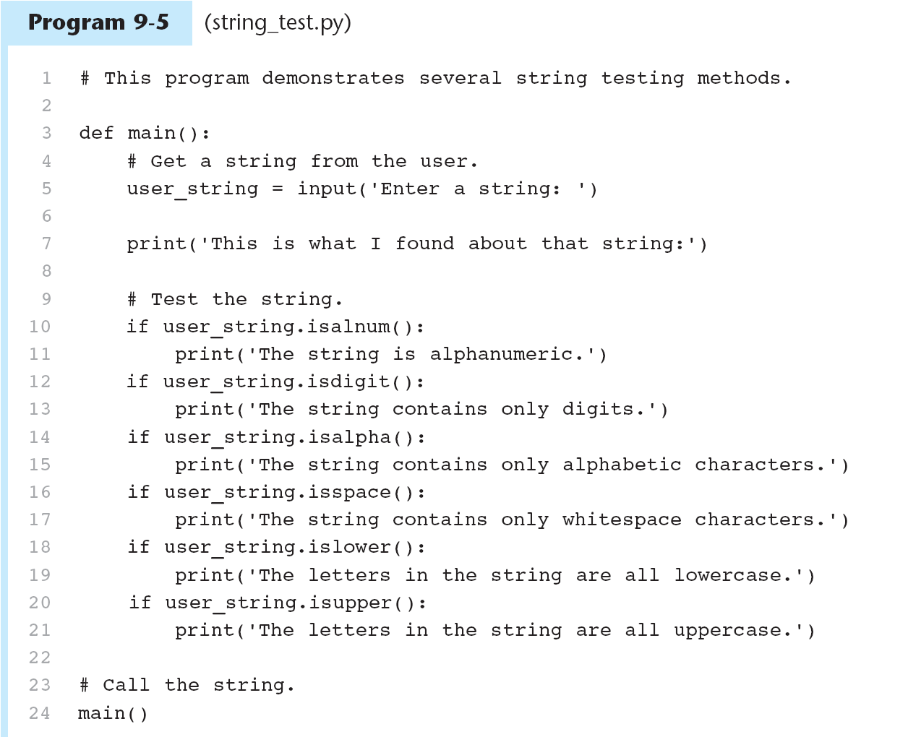

Slide 31
Modification Methods
Although strings are immutable, there are a number of methods that return modified versions of the string

Slide 32
Modification Methods
Examples:
letters = ‘WXYZ’
print (letters, letters.lower())
>>WXYZ wxyz
letters = ‘wxyz’
print (letters, letters.upper())
wxyz WXYZ
These are good for making case-sensitive string comparisons
again = ‘y’
while again.lower() ==‘y’
print (‘Hello’)
print (‘Do you want to see that again?’
again = input (‘y = yes, anything else = no: ‘)

Slide 33
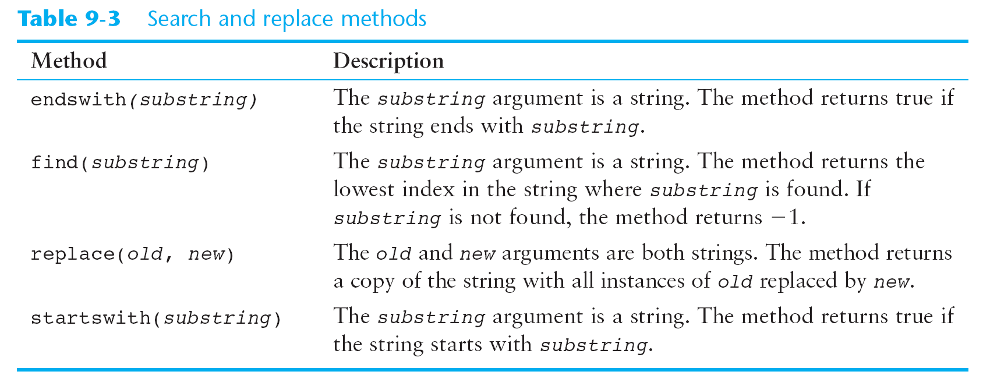
Searching and Replacing
Programs commonly need to search for strings and replace them. The “find” and “replace” capabilities in Word are a good example.

Slide 34
Searching and Replacing
Example with endswith:
filename = input (‘Enter the file name: ‘)
if filename.endswith (‘.txt’):
print (‘That is a text file’)
elif filename.endswith (‘.py’):
print (‘That is a Python file’)
elif filename.endswith (‘.doc’):
print (‘That is a Word file’)
else:
print (‘Unknown file type’)

Slide 35
Validating Characters in a Password
See other string methods @ python. org: string methods
P. 425
Open login.py
Open validate_password.py

Slide 36
The Repetition Operator
The repetition operator works with strings as well as lists:
print (‘Hello’ * 5)
>>HelloHelloHelloHello

Slide 37
The Repetition Operator

Slide 38
Splitting a String
Strings have a method called split that returns a list containing the words in a string
By default split uses spaces as separators
You can specify a different separator by passing it as an argument to split
name_string = ’Sam*Mary*Bob’
name_list = name_string.split(‘*’)
name_list
>>[‘Sam’, ’Mary’, ‘Bob’]

Slide 39
Splitting a String

Slide 40
In-Class Assignment Ch. 8 part 2
Flip case: Write a program to do the following:
Accept the input of a sentence from the user that contains lowercase, uppercase, and special characters.
Make a new sentence in which the lowercase characters are changed to uppercase and the uppercase are changed to lower case. All other characters will retain their original value.
Print the original sentence and the new sentence.

